Slide 1
Chapter 9 Developing Information Literacy and Communication Skills

Slide 2
Assess Your Strengths and Set Goals
Success in your career will depend on your ability to communicate clearly and think critically about information.
What does it mean to be information literate? Can you believe everything you read?

Slide 3
Information Literacy
Information literacy is the ability to find, interpret, and use information
Computer literacy: Ability to use electronic tools to conduct searches and to communicate your findings
Media literacy: Ability to think deeply about what you see and read in broadcast, print, and online media
Cultural literacy: Knowing what has gone on and is going on around you

Slide 4
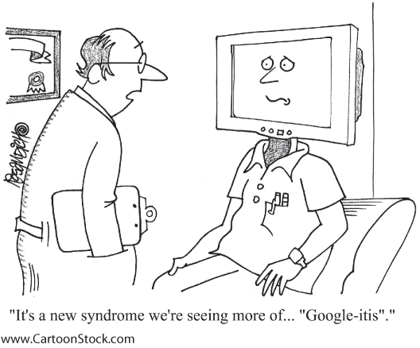
Learning to Be Information Literate
Information literacy involves more than checking links found on a search engine. To be a successful user of information:
Know how to find the information you need.
Learn how to interpret the information you find.
Have a purpose for collecting information.

Slide 5
What’s Research—and What’s Not?
Research is NOT:
Copying a paragraph from a book
Putting together bits of information without adding your own comments
Research IS:
A process of steps used to collect and analyze information to increase understanding of a topic or issue
Notes:
Research also involves asking questions and presenting one or more answers.

Slide 6
Choosing, Narrowing, and Researching a Topic
Choosing a topic is often the most difficult part of a research project:
Decide which particular aspects of the subject to pursue, based on your interests
Create keywords by brainstorming
Narrow your search to about twelve focused and highly relevant hits

Slide 7
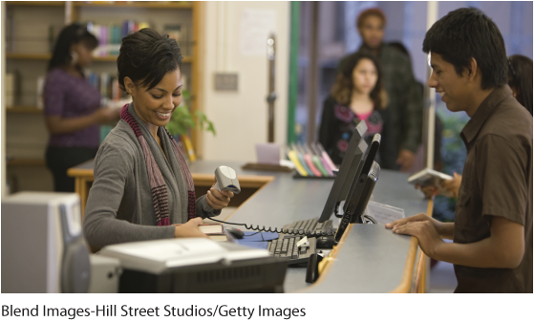
Using the Library
Internet research cannot serve all your needs. Libraries offer:
Books and journals
Electronic databases containing information not available on public Web sites
Collections of documents, photographs, maps, music, and films
Do you know the 20-minute rule?
Notes:
Instructors: Use the question in the slide to generate class discussion. The 20-minute rule is that if a student cannot find something after 20 minutes, to ask a librarian for help. Inform students about the different sources available at a library:
Scholarly articles and journals:
Collect original, peer-reviewed articles
Focus on a specific idea or question
Add filters to refine your search results
Periodicals:
They are designated either by date or by annual volume and issue numbers.
Most are popular rather than scholarly.
Books
Find them by using the library catalog.
Call numbers locate books in the stacks.
When you find the book on the shelf, look at the other books around it.

Slide 8
Tech Tip: Conduct Effective Searches
The Internet is a digital free-for-all. When doing academic research, use these tips to find the best research:
Be picky and filter out what is not helpful.
Understand and use Boolean operators.
Use quotation marks or asterisks when looking for an exact phrase.
Familiarize yourself with the databases your college subscribes to.

Slide 9
Evaluating Sources
The Internet makes research easier in some ways and more difficult in others. Anyone is able to post inaccurate or unauthenticated information
Three important factors to consider:
Relevance
Authority
Bias

Slide 10
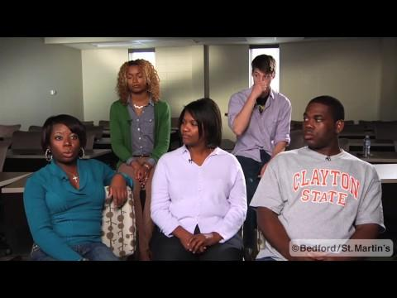
http://drive.google.com/file/d/1R9A2jRbExNr-UjyUJsTq2A5fTPurUlcq/view
Notes:
Possible discussion questions:
Why is it difficult to find a reliable Internet source?
What is your obligation as a researcher to evaluate online resources?
How should skepticism play a role in your evaluation of online resources?

Slide 11
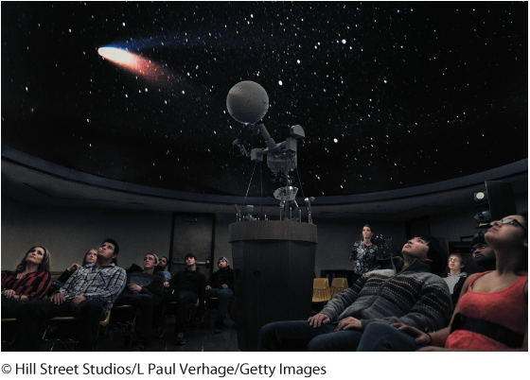
Relevance
Ask if the information is:
Introductory
Definitional
Analytical
Comprehensive
Current
What can you conclude from it?

Slide 12
Authority
Check that:
Information was created by someone qualified
Conclusions are based on solid evidence
Make sure you can identify the author.
Understand whether the project calls for scholarly publications, periodicals, or both.

Slide 13
Bias
All materials have an author who has personal beliefs.
Serious authors have adopted ways to ensure that their opinion doesn’t get in the way of accuracy.
Research consists of considering multiple perspectives, analyzing sources, and creating something new.
What are the signs of bias?
Notes:
Instructors: The answers to the question in the slide can be found in the chapter as follows:
Signs of bias:
Overly positive or overly harsh language
Hints of a personal agenda
Refusal to consider other points of view

Slide 14

Using Your Research in Writing
A major goal of information literacy is to use information effectively to accomplish a specific purpose.
Analyze the information you find and use it to form your own ideas.
Synthesize your information by putting together parts of ideas to form a whole result.

Slide 15
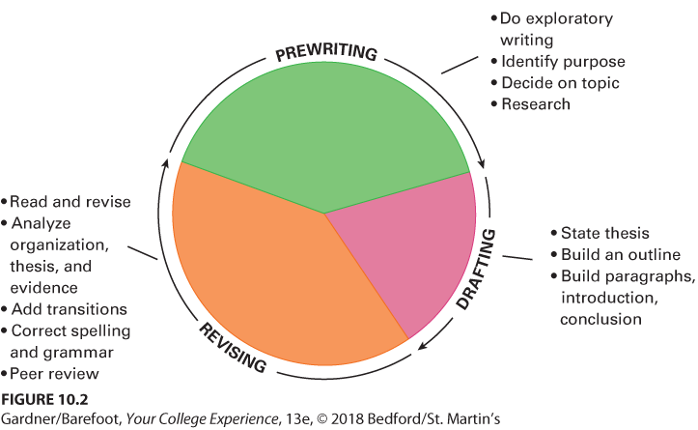
The Writing Process

Slide 16
Step 1: Prewriting
Prewriting means writing things down as they come to mind to discover what you want to say.
The most commonly used method is freewriting, which is writing without worrying about punctuation, grammar, spelling, and background.
Have you tried freewriting before?

Slide 17
Step 2: Drafting
Organize ideas and form a thesis:
Create an outline.
Add analysis and synthesis of your research.
Pay attention to the flow of ideas between sentences and paragraphs.

Slide 18
Step 3: Revising
Key to good writing is rewriting or revising:
After drafting, read once; make initial revisions
Set revised draft aside for at least a day; then reread
May help to get feedback from someone else
Writing or learning center available at most colleges and universities

Slide 19
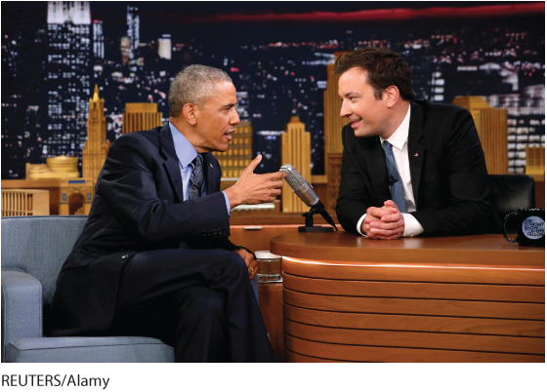
Know Your Audience
For most college assignments, writing used in e-mails, texts, and tweets is not appropriate.
Know when to use abbreviations.
Assume your audience is composed of instructors and other serious students.
Do not be sloppy or casual.

Slide 20
The Importance of Time in the Writing Process
The best writing is done over a period of time
Leave enough time to:
Ask for clarification on the assignment
Seek help from a librarian or the writing center
Narrow or expand your topic
Balance other assignments and commitments
Deal with technology problems

Slide 21
Citing Your Sources
Citations: References that enable a reader to locate a source based on information. It distinguishes borrowed ideas from your own ideas
Provides a starting place for anyone who wants more information
Avoids plagiarism
If you use somebody else’s ideas, even if you paraphrase those ideas, you must give that person credit.

Slide 22
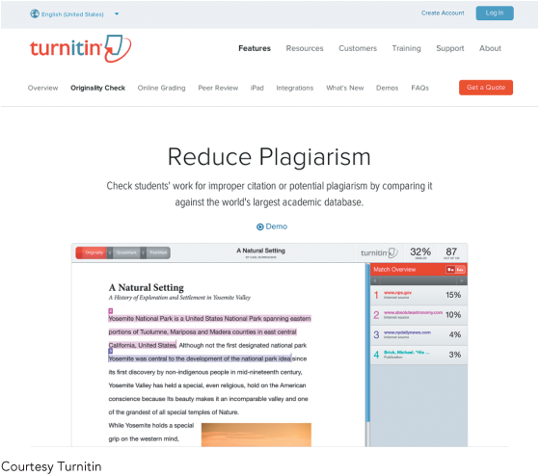
About Plagiarism
Plagiarism: Presenting another person’s ideas or work as your own
It is unacceptable in a college setting (intellectual theft).
Instructors use programs such as Turnitin to identify plagiarism.
Do you know the consequences of plagiarism?
Notes:
Instructors: Ask students if they are familiar with the consequences of plagiarism? Possible consequences include a failing grade, suspension, or even expulsion.

Slide 23
Using Your Research in Presentations
Guidelines for successful speaking
Clarify your objective.
Understand your audience.
Organize your presentation.
What other guidelines should you follow to give a successful presentation?
Notes:
Instructors: Other guidelines to inform students of are:
Choose appropriate visual aids.
Prepare your notes.
Practice your delivery.
Pay attention to word choice and pronunciation.
Dress appropriately.
Request feedback.

Slide 24
Reflection
Accept that research projects and papers are a part of college life.
Take the time and effort to develop your writing and speaking skills.
How will improving your information-literacy skills help you outside of college?

